Slide 1

Cloud Nine
by MAD-HAP
Abhinav Rawal
Daksh Gupta
Piyush Bansal
Adil Vinayak
Manjot Singh Oberoi
Harsh Johar
20103008
20103026
20103030
20103034
20103075
20103076

Slide 2


Problem
Document sharing capability between users and create permissions for the
same.
Create groups and share documents/list of documents within the group with desired security and access privileges
Shared user should be able to login to the application and view/delete the shared documents.
Initiation of mail from application on file sharing and providing smooth user interface.

Slide 3

Our solution
Creation and maintenance of folder structure as well as groups and file sharing within one.
Security within the folder and files along with access rights such as view, update, share, delete and download.
Ensured quick transfer by chunking the file at the client side and synchronously transferring (parallel upload).
Storage efficiency is achieved by compressing the file contents before transfer in the form of a zip file.

Slide 4
File sharing within group
Group Creation and Structure
Resolving conflicts
Access Privileges
Creating Folder structure
Compression and Chunking of files
Enhancing UI
User Authentication
Refining of ideas
Requirement Analysis
Milestones

Slide 5
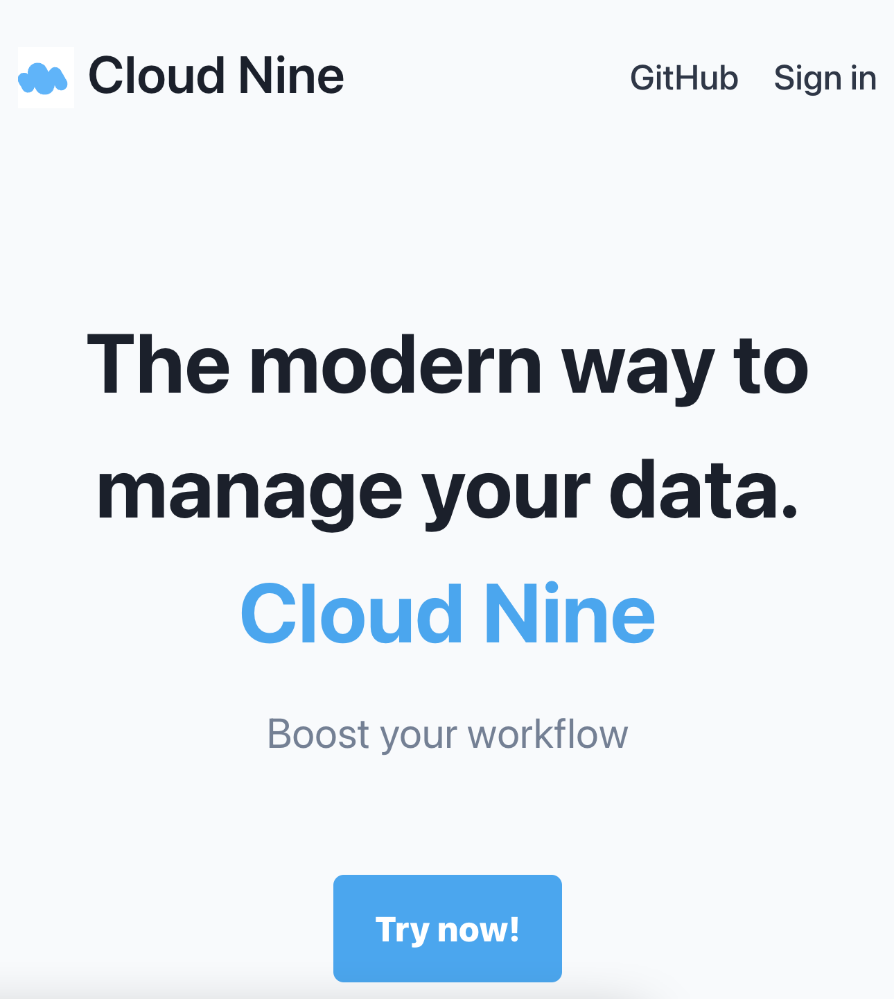

Slide 6

Access rights
Read
Allows the user to read the file.
Update
Allows the user to update the file.
Share
Allows the user to share the file.
Download
Allows the user to download file.
Delete
Allows the user to delete the file.

Slide 7

Chunking & Compression
Dividing data into smaller segments and then recombining them at the point of receival
Storage efficiency is achieved by compressing the file contents before transfer in the form of a zip file.
Notes:
Mention the gamifying of the platform.

Slide 8
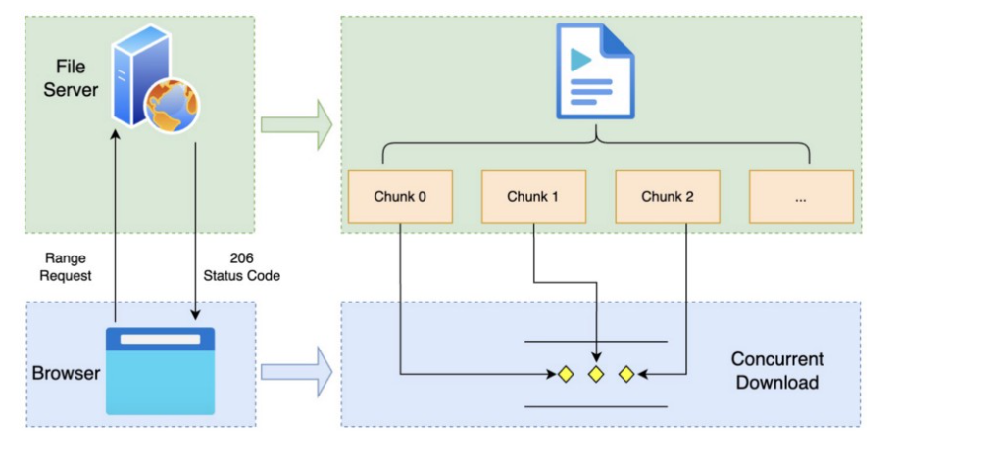

Slide 9

Groups
Share resources, status updates, and more using a single team email address, instead of multiple individual email addresses.
Change access permissions for everyone at once, instead of changing them for each person manually.
Avoid searching for everything you’ve ever shared with someone if they leave your team.

Slide 10
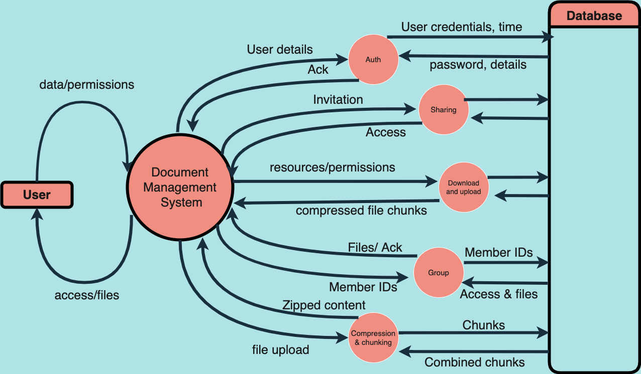
Data flow Diagram

Slide 11
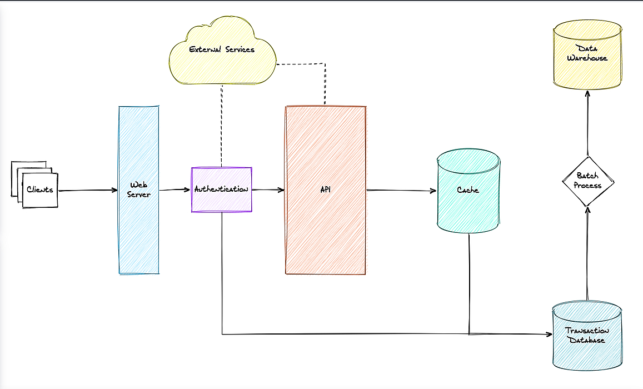
Architecture

Slide 12
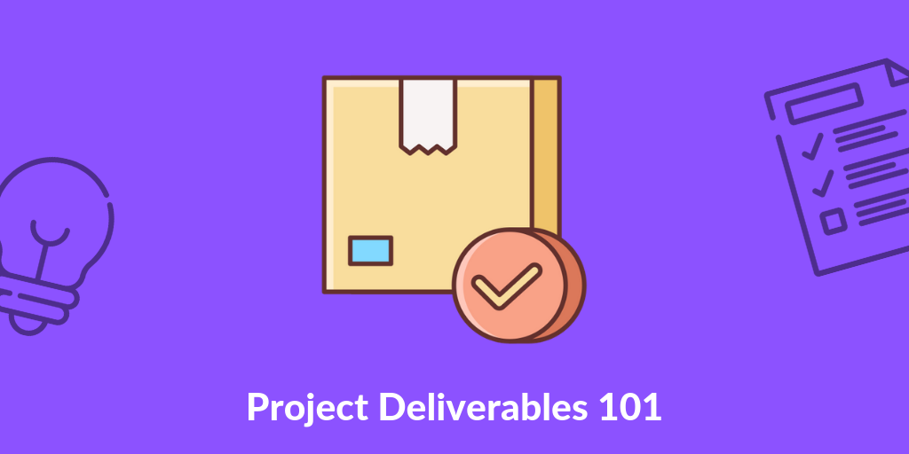
Access Privileges
Chunking and Compression
Group creation and structure
Deliverables

Slide 13
Let’s take a tour

Slide 14
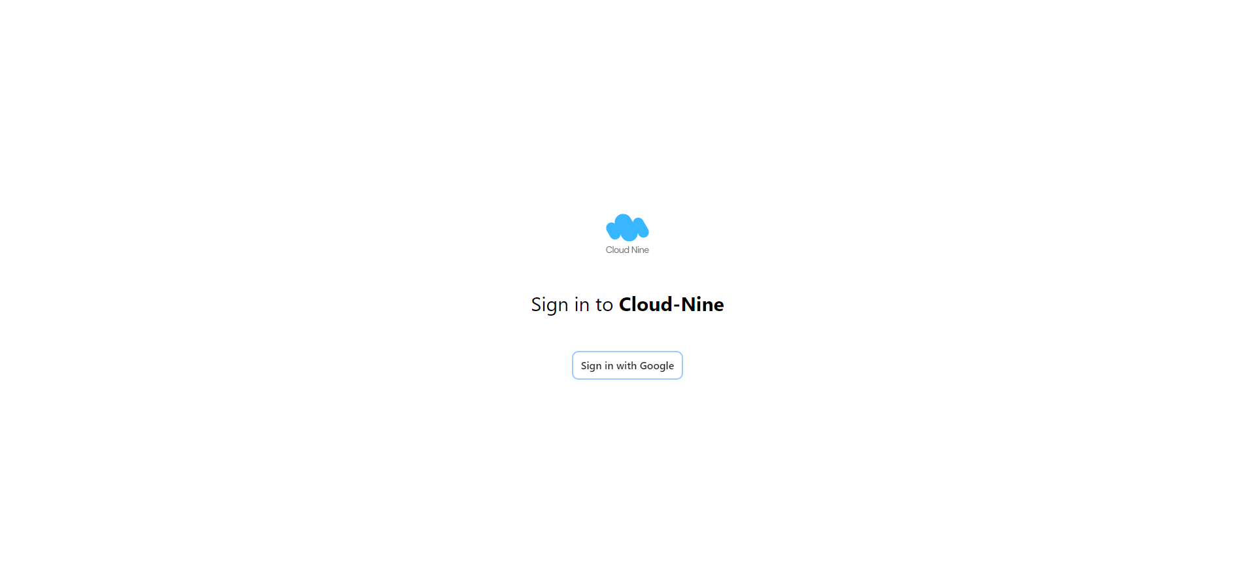
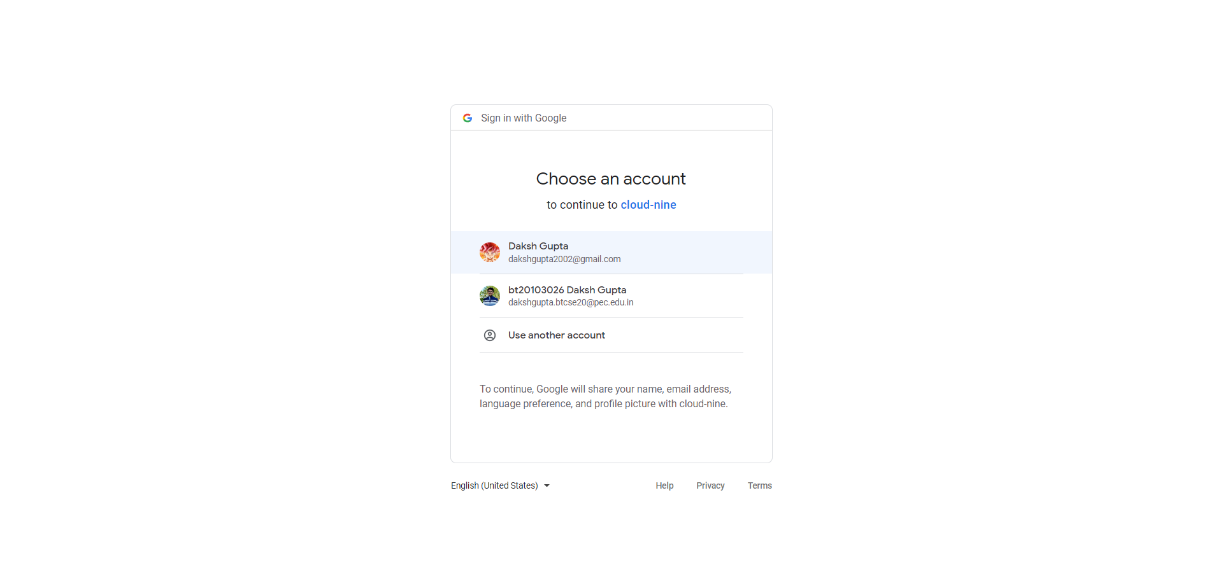
Sign in with google slide

Slide 15
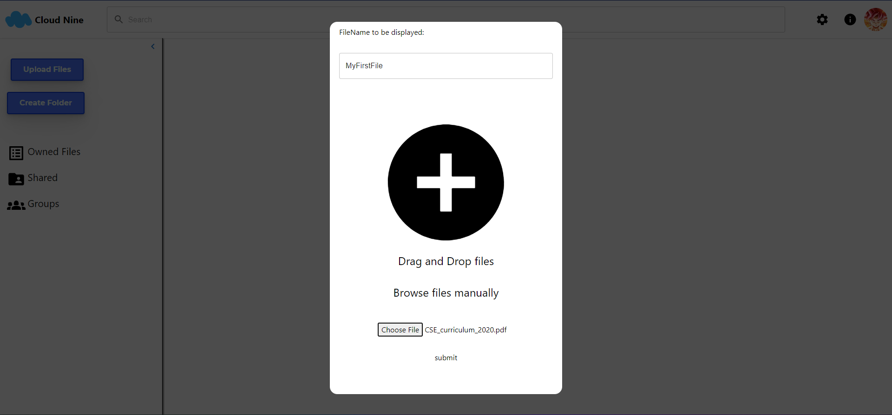
Uploading files and creating folders

Slide 16
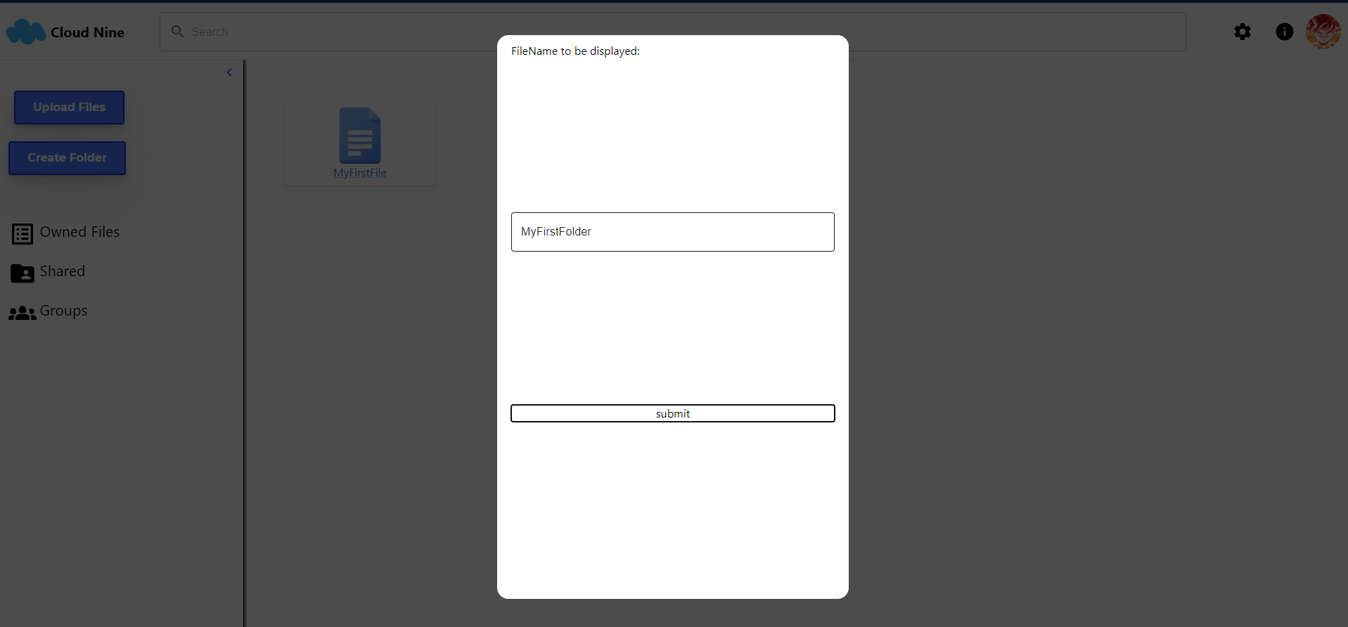
Uploading files and creating folders

Slide 17
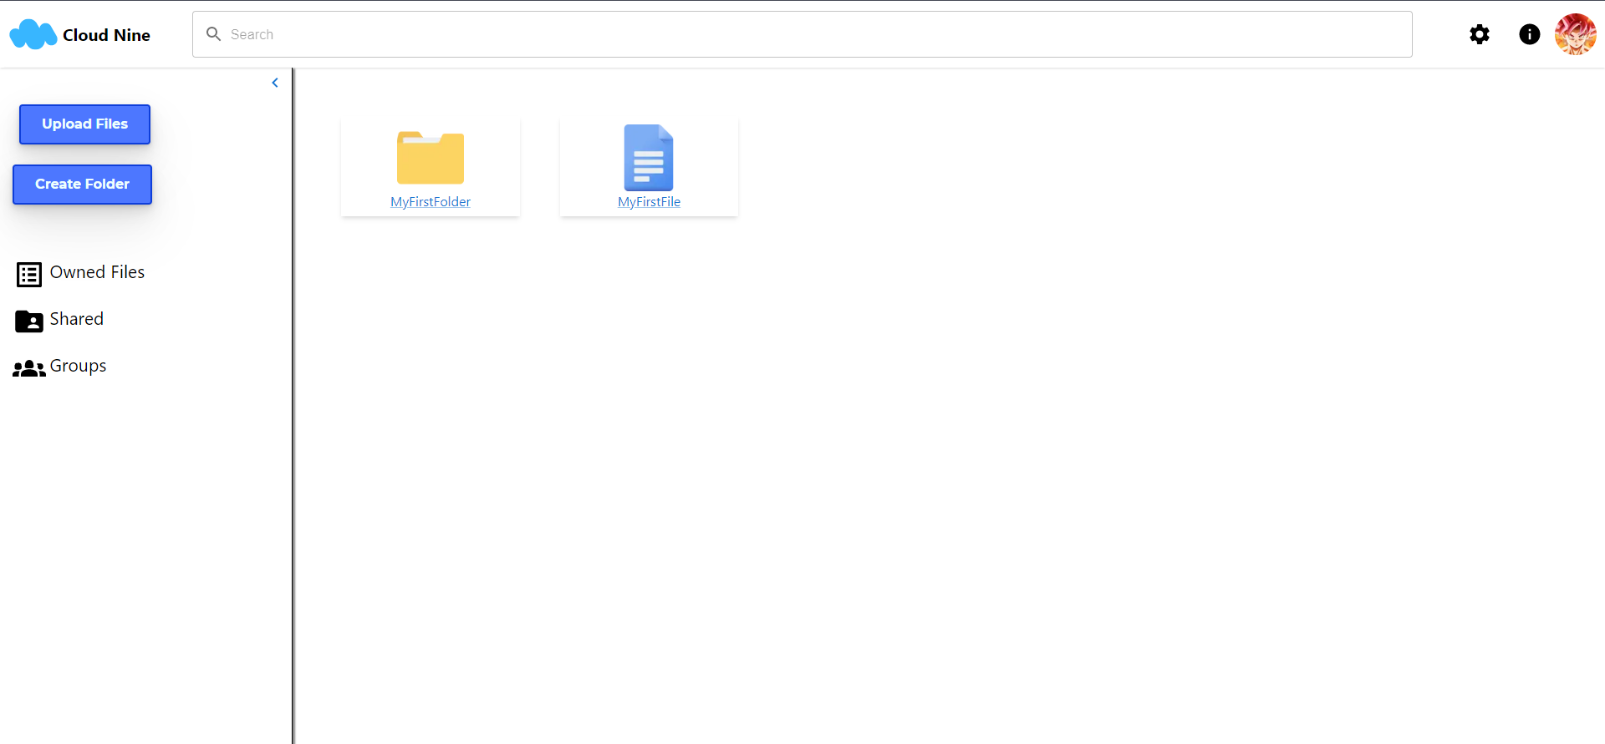
Uploading files and creating folders

Slide 18
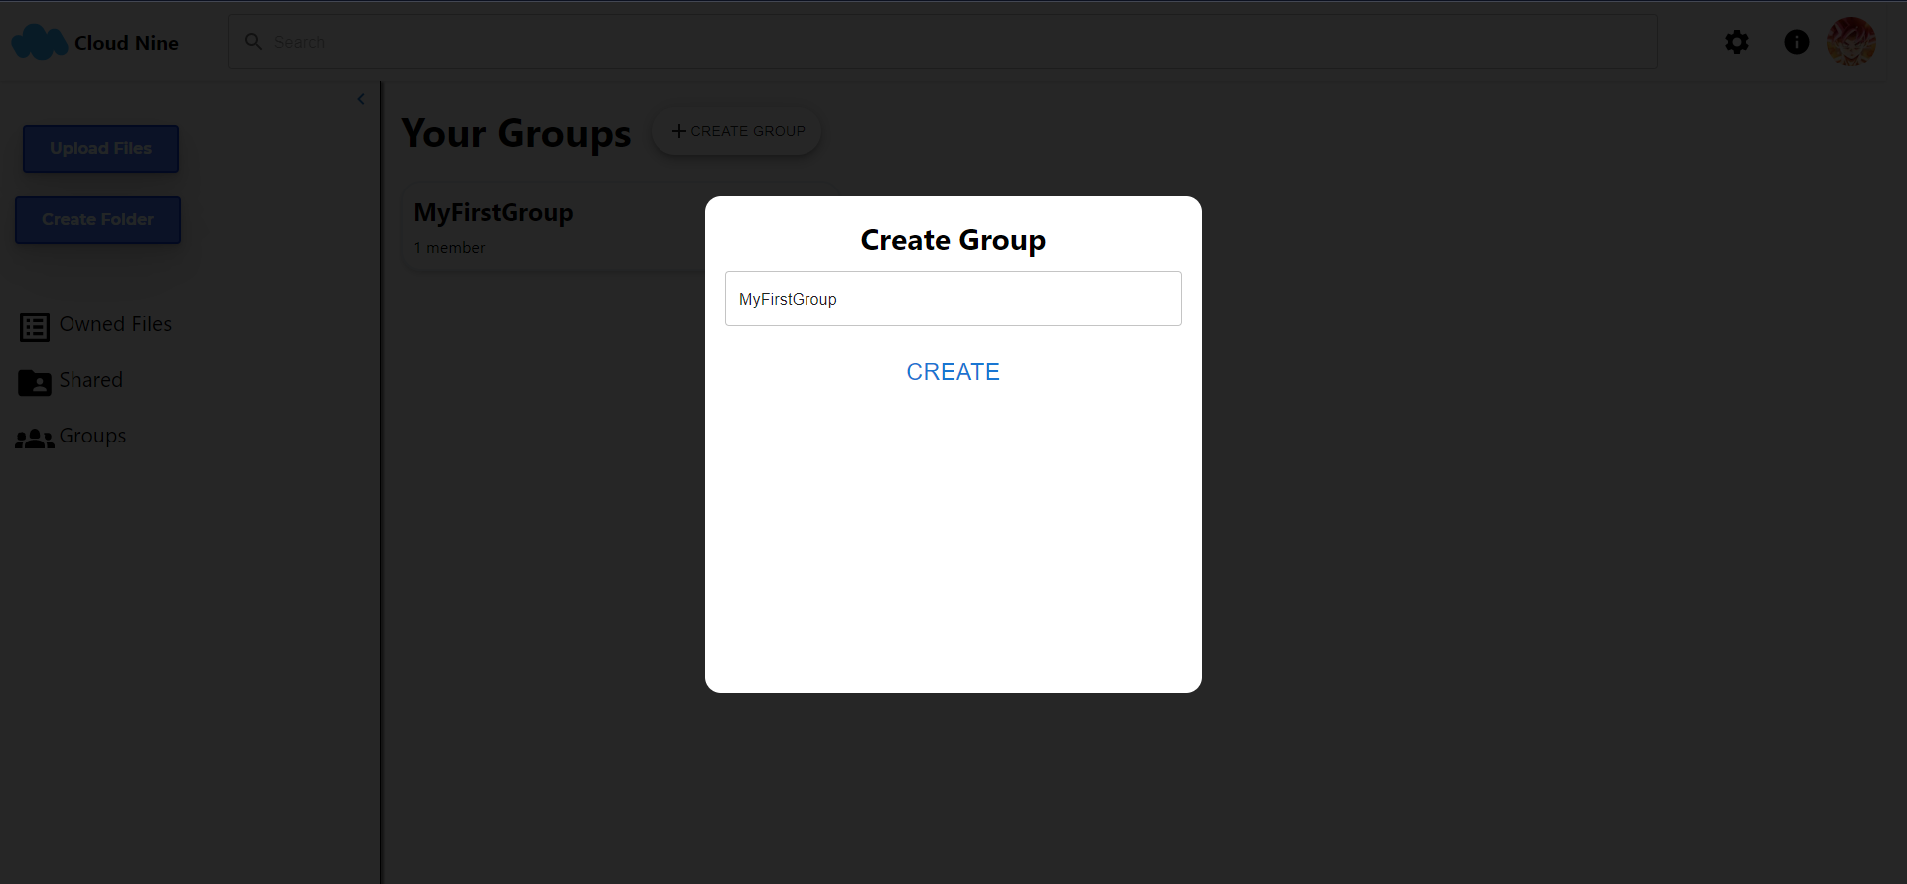
Creating Groups

Slide 19
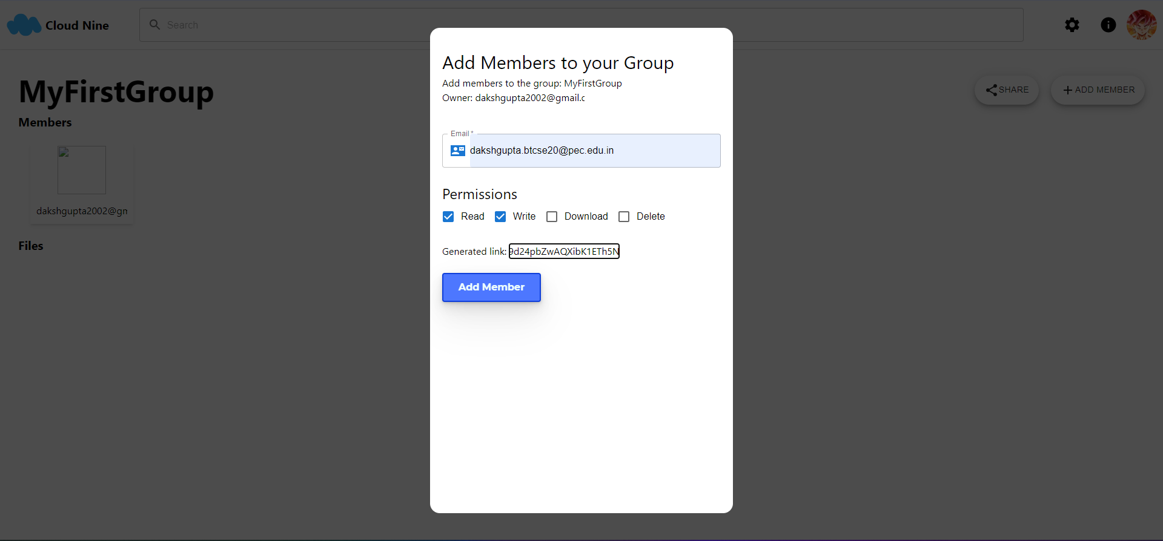
Inviting members to your group

Slide 20
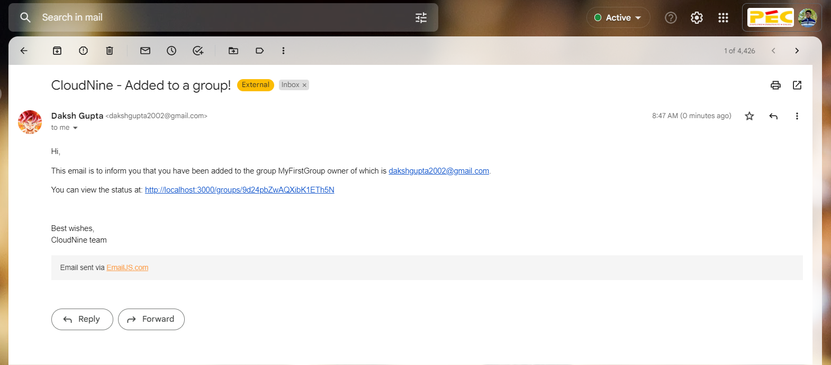
Email received on invitation

Slide 21
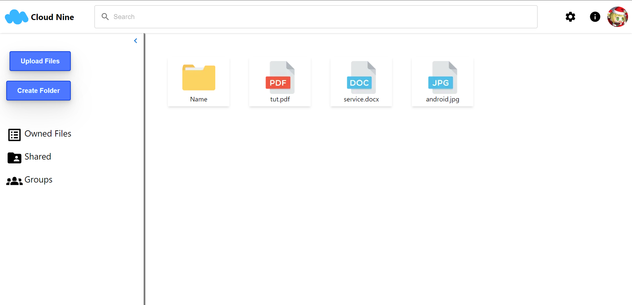
Dashboard

Slide 22

Thank you

